Slide 1
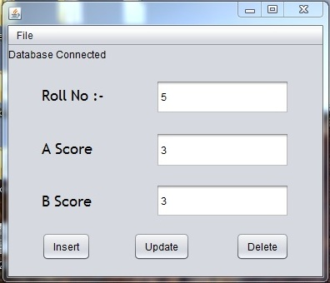
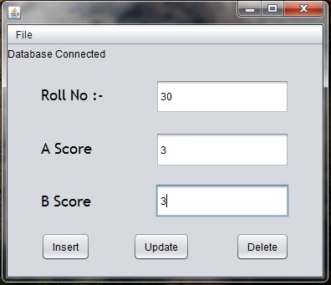
Unit Testing
Using the data collected from our 30 participants we first insert them into our database using the first front end tool.

Slide 2
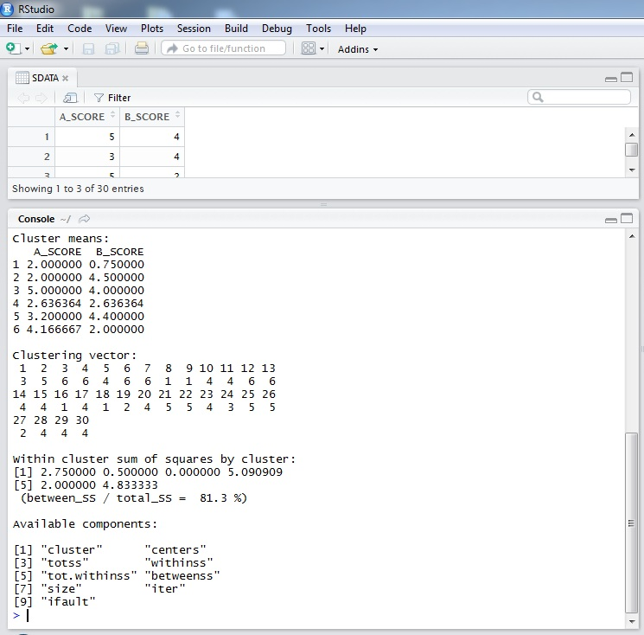
Cont….
Next we used R to formulate the initial clusters.

Slide 3
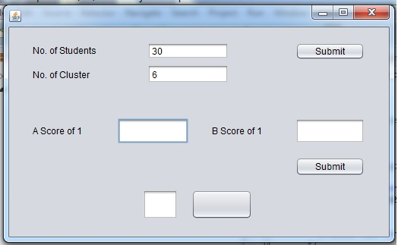
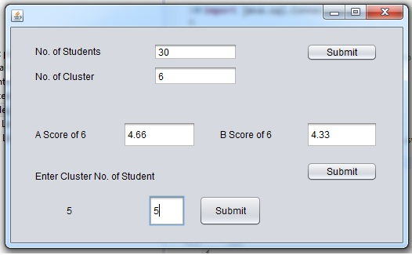
Cont…
Now we used our equalization algorithm and form equal groups

Slide 4
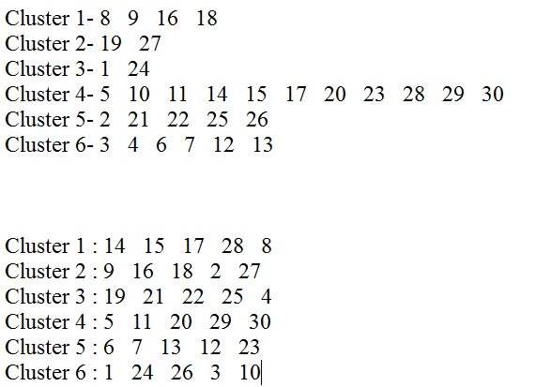
Equalized Groups
We can see the initial clusters formed by the k-means algorithm.
And the equalized groups form by the equalization algorithm.

Slide 5
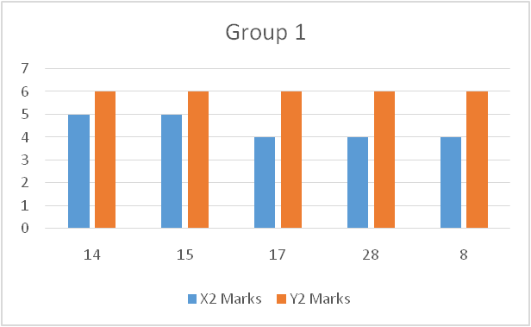
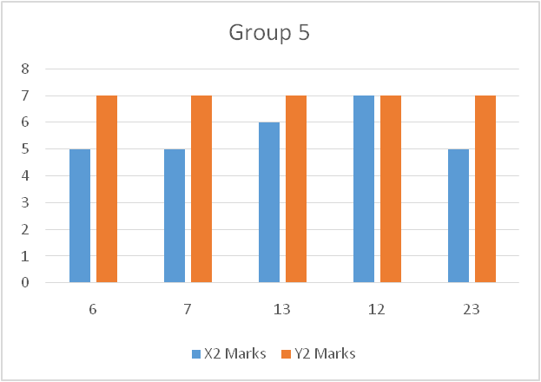
Interpretation
Students who are scored average individually got grouped with students who scored in the some range.
An average increase in all their scores can be observed

Slide 6
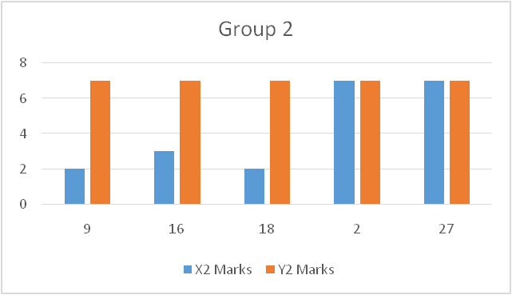
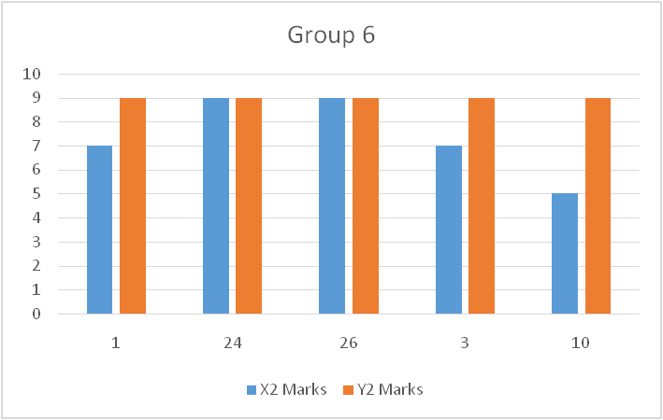
Interpretation
These groups exhibited students from the extreme ends.
However it can be observed that the weaker students have very successfully improved because of their meritoriously better group members.

Slide 7
Limitations
The software does not account for the change in the database User ID and password.
The Fields of the table is fixed.
Compatibility of R with Java is an issue but not an impossibility.
Front End tools seldom throw Exceptions but it does not hinder the working of the front end in any way what-so-ever.
Connection between Database my drop once in a while.

Slide 8
Future Scope
R will be implemented through java as well.
All unchecked Exceptions will be dealt with.
Provision for inclusion of submitting User Id, Password and Table name through the Front End tool.

